Slide 1
CAP442 Web Technology
Unit II
Session 8
II Year M.C.A

Slide 2
Contents
Java Script
Standard Objects
String Objects
Array Objects
Date Objects
Math Object
Window Object
Document Object
Element Objects

Slide 3
DOM Document Object
The document object represents your web page.
If you want to access any element in an HTML page, you always start with accessing the document object.
Below are some examples of how you can use the document object to access and manipulate HTML.
Finding HTML Elements
Method Description
document.getElementById(id) Find an element by element id
document.getElementsByTagName(name) Find elements by tag name
document.getElementsByClassName(name) Find elements by class name

Slide 4

Changing HTML Elements
Property Description
element.innerHTML = new html content Change the inner HTML of an element
element.attribute = new value Change the attribute value of an HTML element
element.style.property = new style Change the style of an HTML element
Method Description
element.setAttribute(attribute, value) Change the attribute value of an HTML element

Slide 5
Adding and Deleting Elements
Method Description
document.createElement(element) Create an HTML element
document.removeChild(element) Remove an HTML element
document.appendChild(element) Add an HTML element
document.replaceChild(new, old) Replace an HTML element
document.write(text) Write into the HTML output stream

Slide 6
Adding Events Handlers
Method Description
document.getElementById(id).onclick = function(){code} Adding event handler code to an onclick event

Slide 7
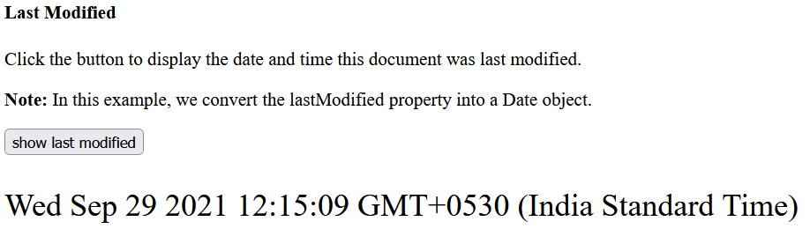
Last modified:
The lastModified property returns the date and time the current document was last modified.
Note: This property is read-only.
<button onclick="showLastModified()">
show last modified</button>
<p id="demo" style="font-size: 24px;"> </p>
<script>
function showLastModified() {
var x = new Date(document.lastModified);
document.getElementById("demo").innerHTML = x;
}
</script>

Slide 8
document.getElementById(id) method:
The getElementById() method returns the element that has the ID attribute with the specified value.
This method is one of the most common methods in the HTML DOM, and is used almost every time you want to manipulate, or get info from, an element on your document.
Returns null if no elements with the specified ID exists.
An ID should be unique within a page. However, if more than one element with the specified ID exists, the getElementById() method returns the first element in the source code.

Slide 9
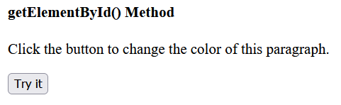
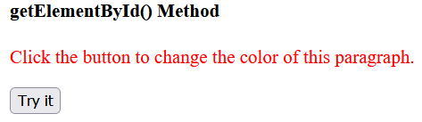
<p id="demo">Click the button to change the color of this paragraph.</p>
<button onclick="myFunction()">Try it</button>
<script>
function myFunction() {
var x = document.getElementById("demo");
x.style.color = "red";
}
</script>

Slide 10

document.getElementsByName() method:
The getElementsByName() method returns a collection of all elements in the document with the specified name (the value of the name attribute), as an HTMLCollection object.
The HTMLCollection object represents a collection of nodes. The nodes can be accessed by index numbers. The index starts at 0.
Find out how many elements there are in the document that have a name attribute with the value "animal" (using the length property of the HTMLCollection object):
var x = document.getElementsByName("animal").length;

Slide 11
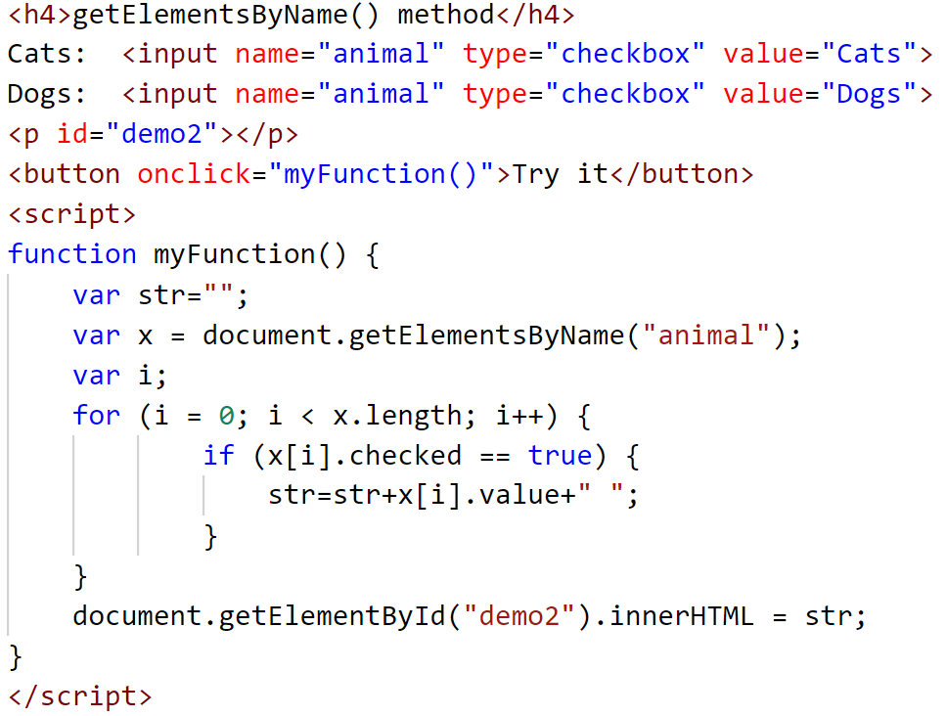
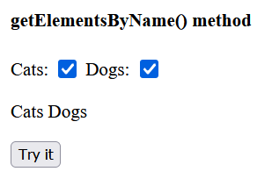
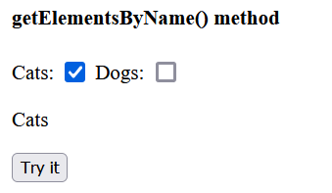

Example: This example display the text values of checked check boxes.

Slide 12
addEventListener() method:
The addEventListener() method attaches an event handler to the specified element.
The addEventListener() method attaches an event handler to an element without overwriting existing event handlers.
You can add many event handlers to one element.
You can add many event handlers of the same type to one element, i.e two "click" events.
You can add event listeners to any DOM object not only HTML elements. i.e the window object.

Slide 13
When using the addEventListener() method, the JavaScript is separated from the HTML markup, for better readability and allows you to add event listeners even when you do not control the HTML markup.
You can easily remove an event listener by using the removeEventListener() method.

Slide 14
Syntax
element.addEventListener(event, function, useCapture);
The first parameter is the type of the event (like "click" or "mousedown" or any other HTML DOM Event.)
The second parameter is the function we want to call when the event occurs.
The third parameter is a boolean value specifying whether to use event bubbling or event capturing. This parameter is optional.
Note that you don't use the "on" prefix for the event; use "click" instead of "onclick".

Slide 15
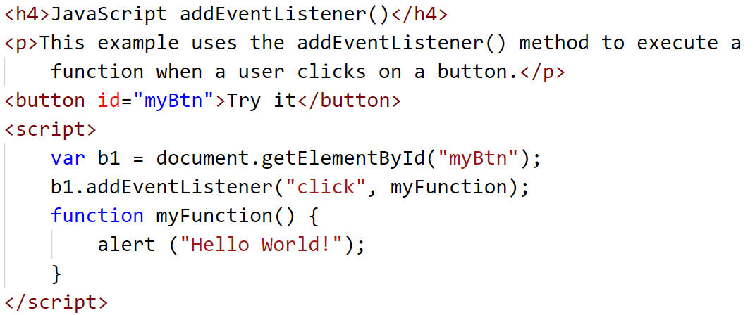

Slide 16
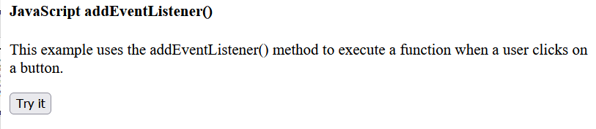
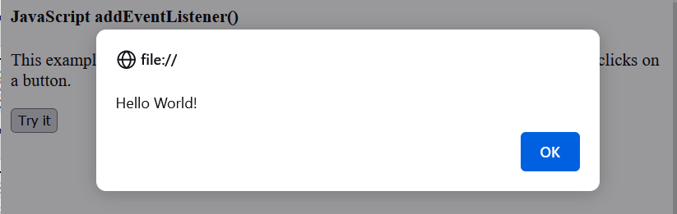

Slide 17
createElement() Method
The createElement() method creates an Element Node with the specified name.
Note: After the element is created, use the element.appendChild() or element.insertBefore() method to insert it to the document.
Syntax
document.createElement(nodename)

Slide 18
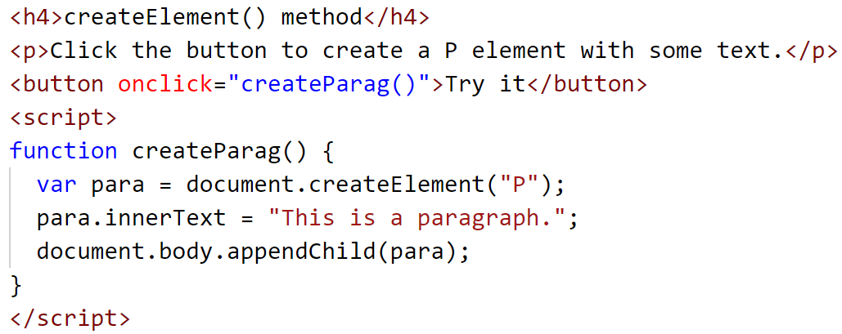
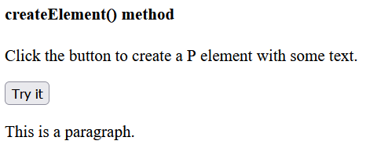
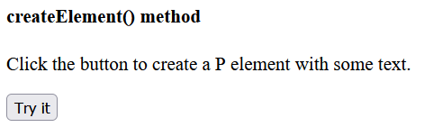


Slide 19
querySelector() Method
The querySelector() method returns the first element that matches a specified CSS selector(s) in the document.
Note: The querySelector() method only returns the first element that matches the specified selectors. To return all the matches, use the querySelectorAll() method instead.
If the selector matches an ID in document that is used several times (Note that an "id" should be unique within a page and should not be used more than once), it returns the first matching element.

Slide 20
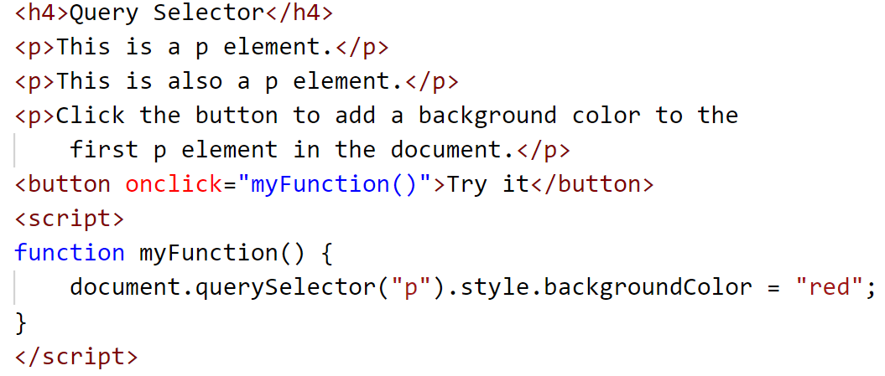

Slide 21
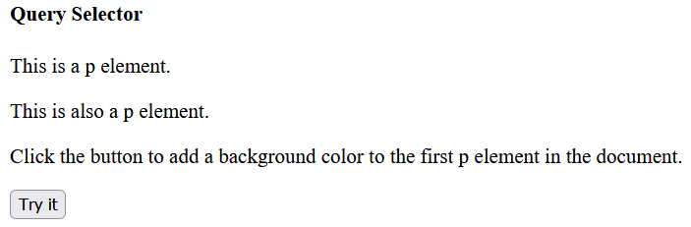
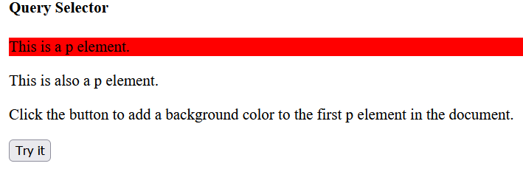

Slide 22
The Element Object
In the HTML DOM, the Element object represents an HTML element, like P, DIV, A, TABLE, or any other HTML element.
The following properties and methods can be used on all HTML elements:
Property / Method Description
accessKey Sets or returns the accesskey attribute of an element
addEventListener() Attaches an event handler to the specified element
appendChild() Adds a new child node, to an element, as the last child node
attributes Returns a NamedNodeMap of an element's attributes
blur() Removes focus from an element
childElementCount Returns the number of child elements an element has
childNodes Returns a collection of an element's child nodes (including text and comment nodes)

Slide 23
Property / Method Description
children Returns a collection of an element's child element (excluding text and comment nodes)
classList Returns the class name(s) of an element
className Sets or returns the value of the class attribute of an element
click() Simulates a mouse-click on an element
clientHeight Returns the height of an element, including padding
clientLeft Returns the width of the left border of an element
clientTop Returns the width of the top border of an element
clientWidth Returns the width of an element, including padding
cloneNode() Clones an element
closest() Searches up the DOM tree for the closest element which matches a specified CSS selector

Slide 24
Property / Method Description
compareDocumentPosition() Compares the document position of two elements
contains() Returns true if a node is a descendant of a node, otherwise false
contentEditable Sets or returns whether the content of an element is editable or not
dir Sets or returns the value of the dir attribute of an element
exitFullscreen() Cancels an element in fullscreen mode
firstChild Returns the first child node of an element
firstElementChild Returns the first child element of an element
focus() Gives focus to an element
getAttribute() Returns the specified attribute value of an element node

Slide 25
Property / Method Description
getAttributeNode() Returns the specified attribute node
getBoundingClientRect() Returns the size of an element and its position relative to the viewport
getElementsByClassName() Returns a collection of all child elements with the specified class name
getElementsByTagName() Returns a collection of all child elements with the specified tag name
hasAttribute() Returns true if an element has the specified attribute, otherwise false
hasAttributes() Returns true if an element has any attributes, otherwise false
hasChildNodes() Returns true if an element has any child nodes, otherwise false
id Sets or returns the value of the id attribute of an element
innerHTML Sets or returns the content of an element
innerText Sets or returns the text content of a node and its descendants

Slide 26
Property / Method Description
insertAdjacentElement() Inserts a HTML element at the specified position relative to the current element
insertAdjacentHTML() Inserts a HTML formatted text at the specified position relative to the current element
insertAdjacentText() Inserts text into the specified position relative to the current element
insertBefore() Inserts a new child node before a specified, existing, child node
isContentEditable Returns true if the content of an element is editable, otherwise false
isDefaultNamespace() Returns true if a specified namespaceURI is the default, otherwise false
isEqualNode() Checks if two elements are equal
isSameNode() Checks if two elements are the same node
isSupported() Returns true if a specified feature is supported on the element

Slide 27
Property / Method Description
matches() Returns a Boolean value indicating whether an element is matched by a specific CSS selector or not
namespaceURI Returns the namespace URI of an element
nextSibling Returns the next node at the same node tree level
nextElementSibling Returns the next element at the same node tree level
nodeName Returns the name of a node
nodeType Returns the node type of a node
nodeValue Sets or returns the value of a node
normalize() Joins adjacent text nodes and removes empty text nodes in an element
offsetHeight Returns the height of an element, including padding, border and scrollbar
offsetWidth Returns the width of an element, including padding, border and scrollbar

Slide 28
Property / Method Description
offsetLeft Returns the horizontal offset position of an element
offsetParent Returns the offset container of an element
offsetTop Returns the vertical offset position of an element
outerHTML Sets or returns the content of an element (including the start tag and the end tag)
outerText Sets or returns the outer text content of a node and its descendants
ownerDocument Returns the root element (document object) for an element
parentNode Returns the parent node of an element
parentElement Returns the parent element node of an element
previousSibling Returns the previous node at the same node tree level
previousElementSibling Returns the previous element at the same node tree level

Slide 29
Property / Method Description
querySelector() Returns the first child element that matches a specified CSS selector(s) of an element
querySelectorAll() Returns all child elements that matches a specified CSS selector(s) of an element
remove() Removes the element from the DOM
removeAttribute() Removes a specified attribute from an element
removeAttributeNode() Removes a specified attribute node, and returns the removed node
removeChild() Removes a child node from an element
removeEventListener() Removes an event handler that has been attached with the addEventListener() method
replaceChild() Replaces a child node in an element
requestFullscreen() Shows an element in fullscreen mode
scrollHeight Returns the entire height of an element, including padding

Slide 30
Property / Method Description
scrollIntoView() Scrolls the specified element into the visible area of the browser window
scrollLeft Sets or returns the number of pixels an element's content is scrolled horizontally
scrollTop Sets or returns the number of pixels an element's content is scrolled vertically
scrollWidth Returns the entire width of an element, including padding
setAttribute() Sets or changes the specified attribute, to the specified value
setAttributeNode() Sets or changes the specified attribute node
style Sets or returns the value of the style attribute of an element
tabIndex Sets or returns the value of the tabindex attribute of an element
tagName Returns the tag name of an element
textContent Sets or returns the textual content of a node and its descendants
title Sets or returns the value of the title attribute of an element
toString() Converts an element to a string

Slide 31
JavaScript Events
HTML events are "things" that happen to HTML elements.
When JavaScript is used in HTML pages, JavaScript can "react" on these events.
An HTML event can be something the browser does, or something a user does.
Here are some examples of HTML events:
An HTML web page has finished loading
An HTML input field was changed
An HTML button was clicked

Slide 32
JavaScript lets you execute code when events are detected.
HTML allows event handler attributes, with JavaScript code, to be added to HTML elements.
With single quotes:
<element event='some JavaScript'>
With double quotes:
<element event="some JavaScript">

Slide 33


In the following example, an onclick attribute (with code), is added to a <button> element:
Example
<button onclick="document.getElementById('demo').innerHTML = Date()">The time is?</button>
In the example above, the JavaScript code changes the content of the element with id="demo".

Slide 34

In the next example, the code changes the content of its own element (using this.innerHTML):
Example
<button onclick="this.innerHTML = Date()">The time is?</button>

Slide 35
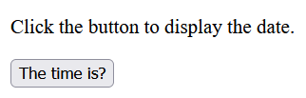
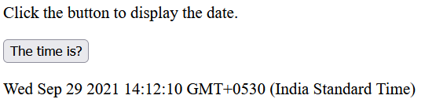
JavaScript code is often several lines long. It is more common to see event attributes calling functions:
Example
<button onclick="displayDate()">The time is?</button>

Slide 36
Common HTML Events
Event Description
onchange An HTML element has been changed
onclick The user clicks an HTML element
onmouseover The user moves the mouse over an HTML element
onmouseout The user moves the mouse away from an HTML element
onkeydown The user pushes a keyboard key
onload The browser has finished loading the page

